Slide 1

here for beer
…got no beer

Slide 2
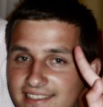
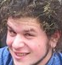
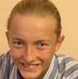
our team gui
Taras Roshko
Danylo Dutka
Vitaliy Zasadnyy
…all are students

Slide 3
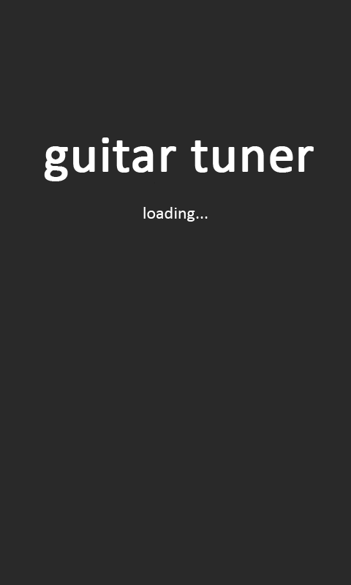
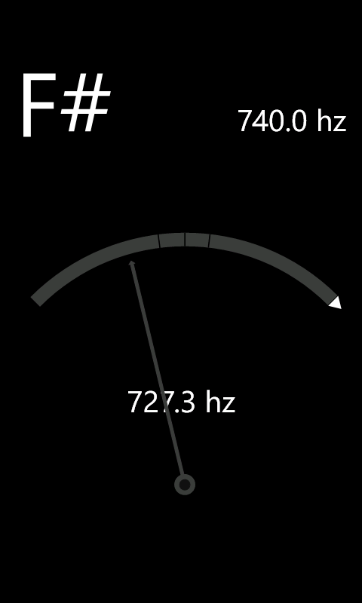
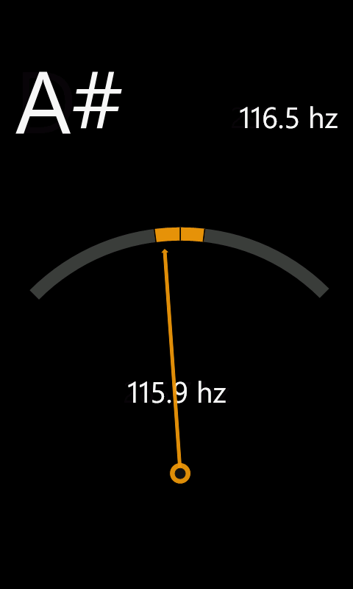
guitar tuner u
…great user experience

Slide 4
features ques
always with you, even in nature
quick tune for musical instruments
simple and intuitive interface
…made for professionals

Slide 5
questions ?
…thank you for your attention

